Slide 1
A Medical Examination of the Crucifixion

Slide 2
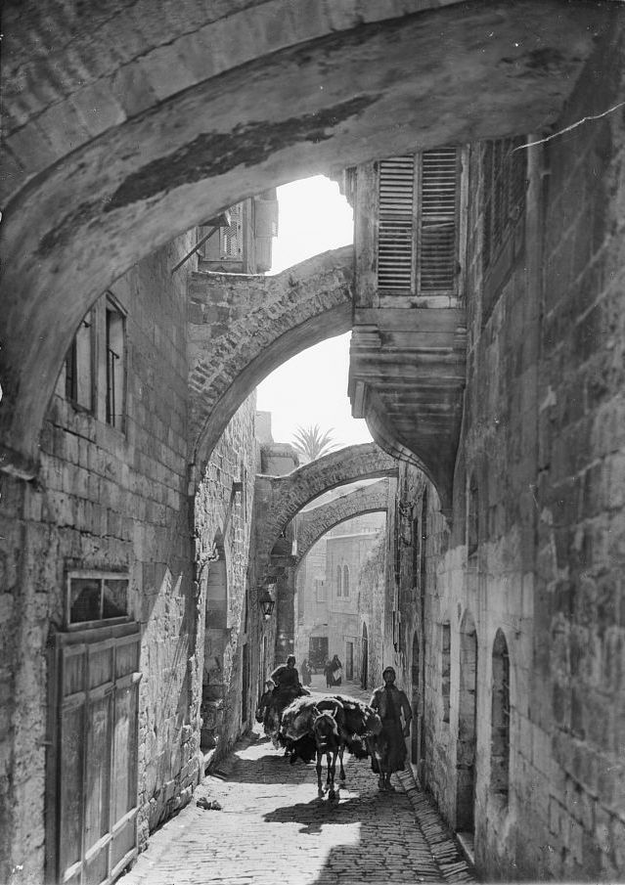

Slide 3
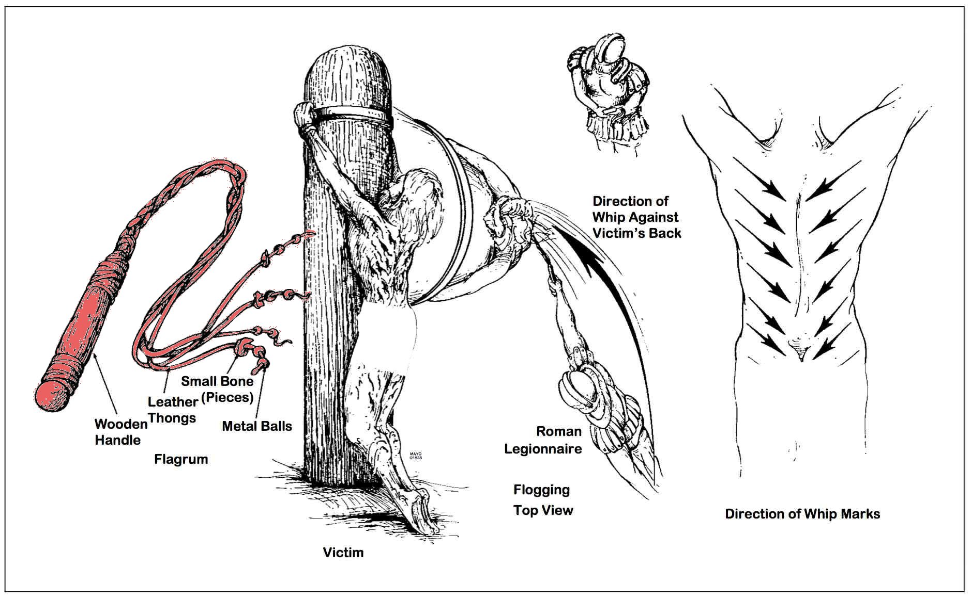

Slide 4
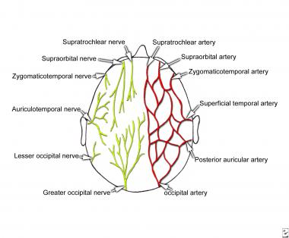

Slide 5
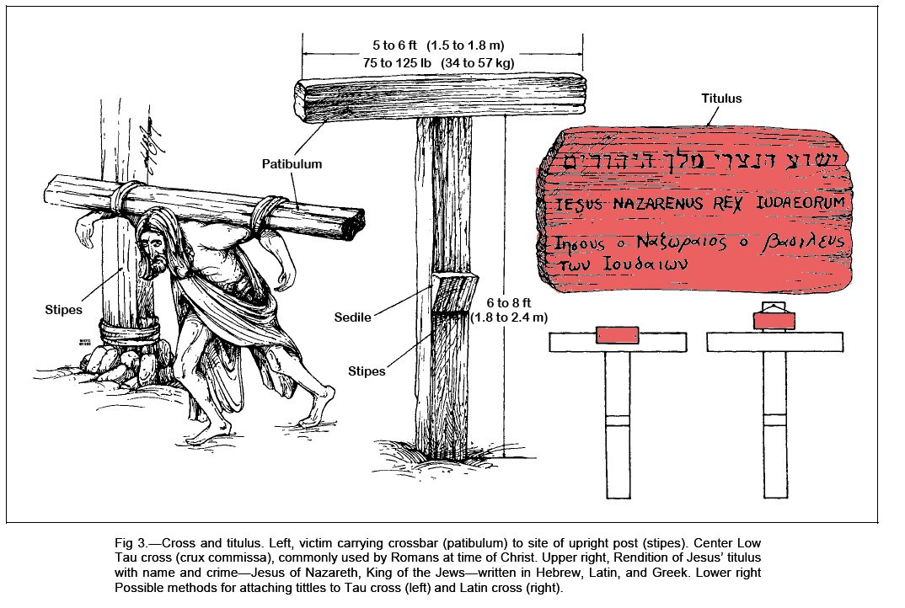

Slide 6
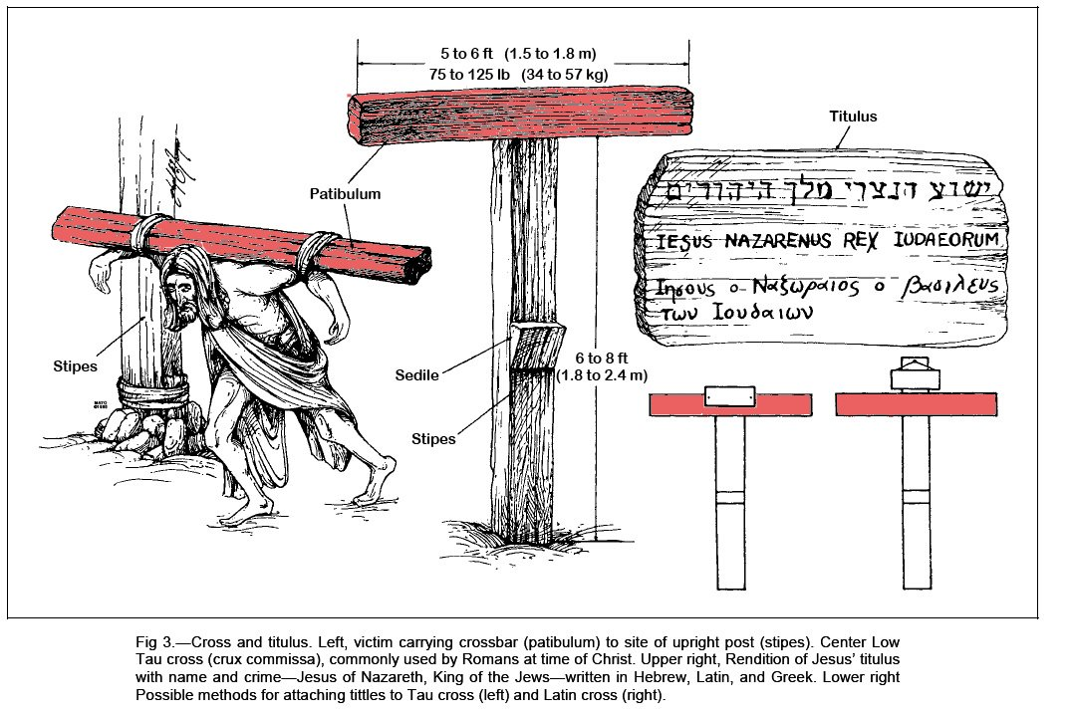

Slide 7
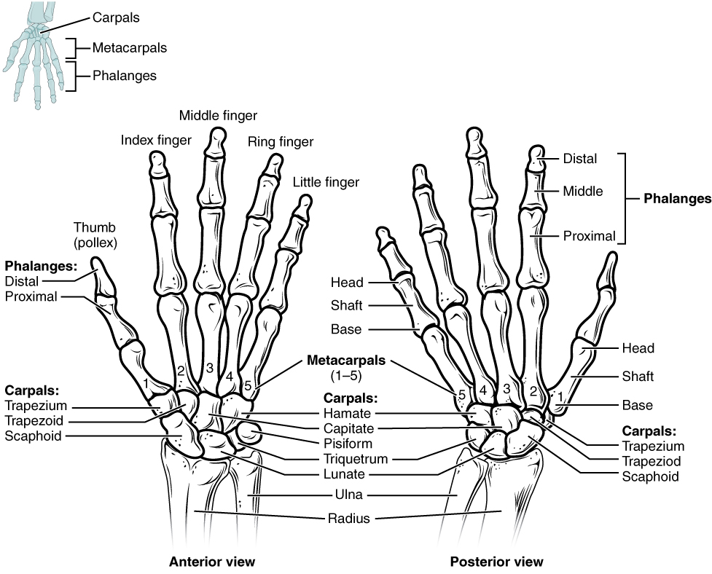

Slide 8
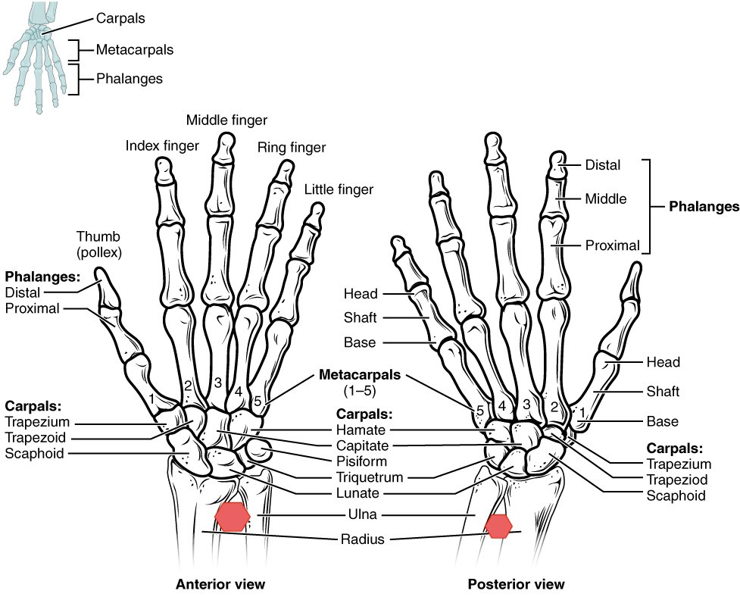

Slide 9
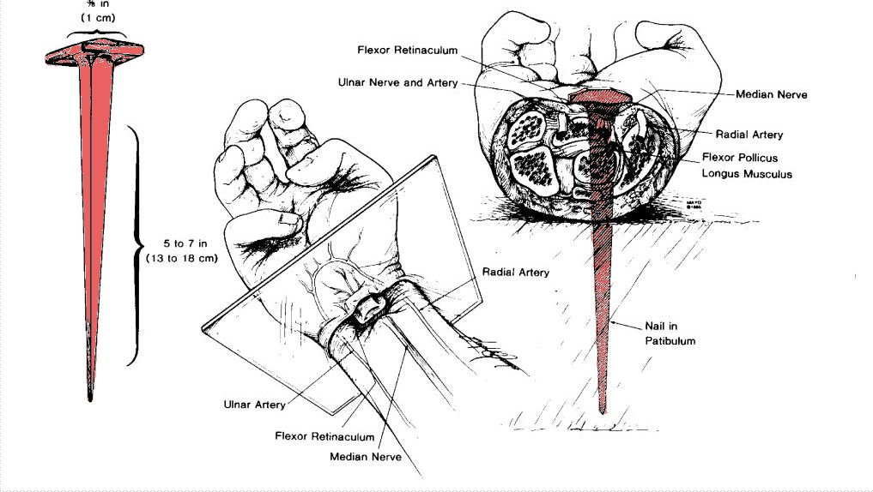

Slide 10
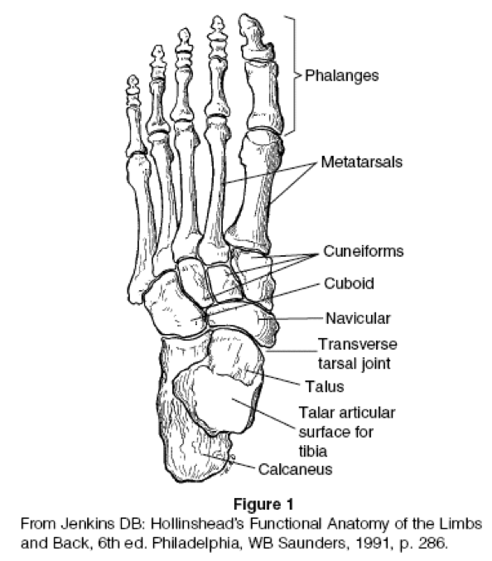
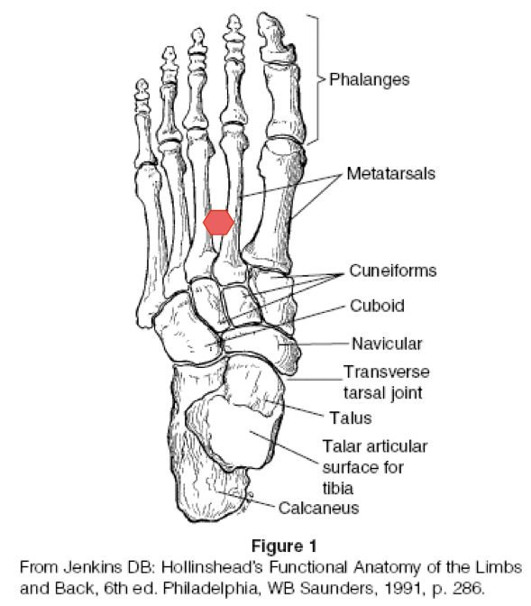

Slide 12
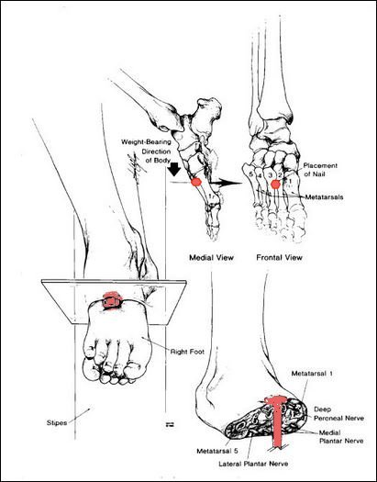

Slide 13
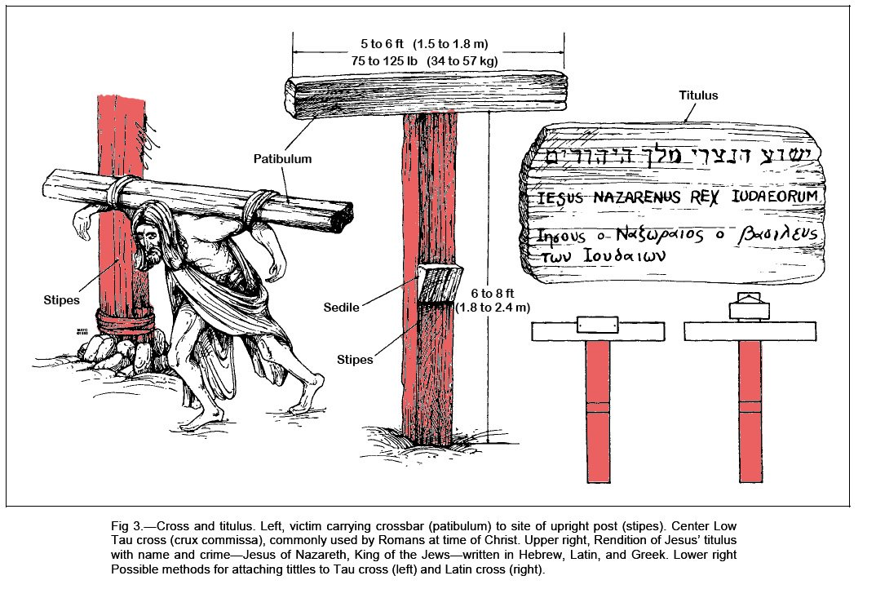

Slide 14
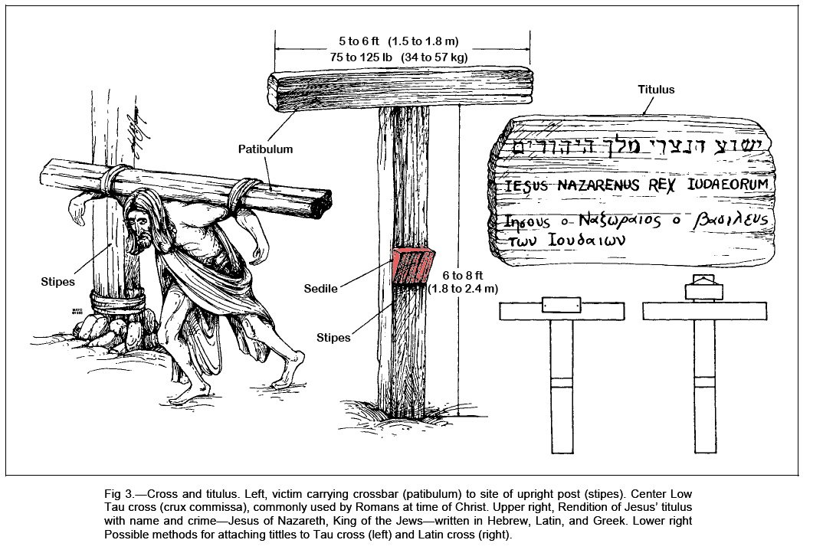

Slide 15
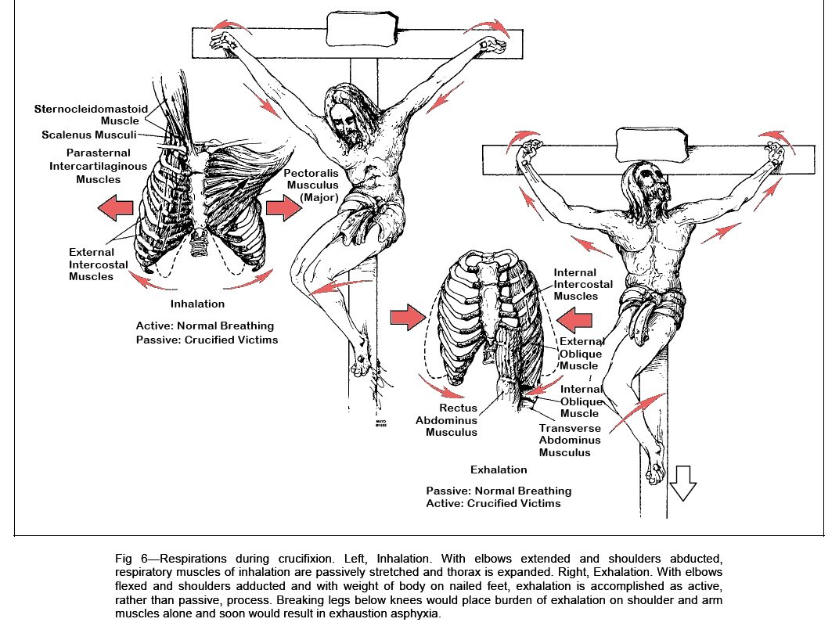

Slide 16
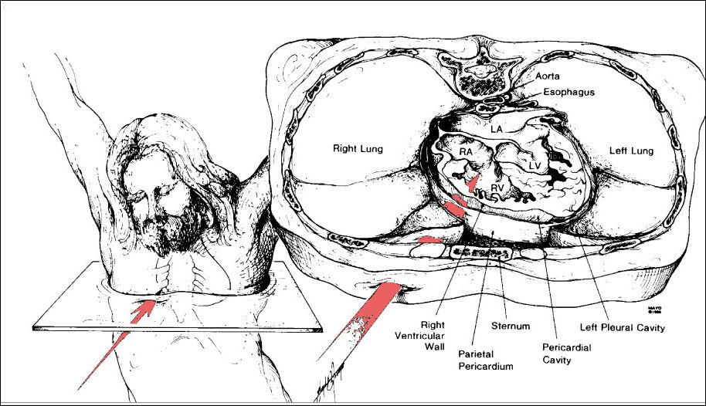

Slide 17
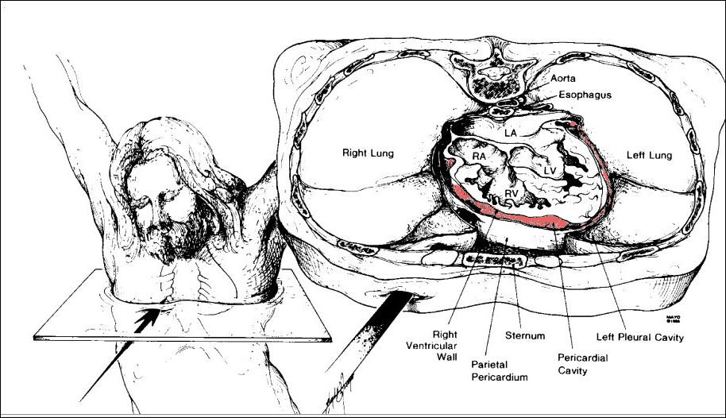

Slide 18
hemohidrosis or hematidrosis – sweating blood
atelectasis - lung collapse
hypoxia – tissues deprived of adequate oxygen to function
hypercarbia - abnormally elevated carbon dioxide (CO₂) levels in the blood.
respiratory acidosis – condition that occurs when the lungs can’t remove enough of the carbon dioxide (CO2) produced by the body. Excess CO2 causes the pH of blood and other bodily fluids to decrease, making them too acidic.
pleural effusion - fluids build up in the lungs
pericardial effusion - fluids then build-up around the heart
myocardial rupture - a laceration or tearing of the wall of the ventricles or atria of the heart

Slide 19
I John 5:9-13
⁹ If we receive the witness of men, the witness of God is greater: for this is the witness of God which he hath testified of his Son. ¹⁰ He that believeth on the Son of God hath the witness in himself: he that believeth not God hath made him a liar; because he believeth not the record that God gave of his Son. ¹¹ And this is the record, that God hath given to us eternal life, and this life is in his Son. ¹² He that hath the Son hath life; and he that hath not the Son of God hath not life. ¹³ These things have I written unto you that believe on the name of the Son of God; that ye may know that ye have eternal life, and that ye may believe on the name of the Son of God.

Slide 20
Who Raised Christ?
God The Father raised Jesus from the dead
Romans 10:9 That if thou shalt confess with thy mouth the Lord Jesus, and shalt believe in thine heart that God hath raised him from the dead, thou shalt be saved.
Ac 5:30 The God of our fathers raised up Jesus, whom ye slew and hanged on a tree.
Jesus raised Himself from the dead
John 2:19-21 Jesus answered and said unto them, Destroy this temple, and in three days I will raise it up. Then said the Jews, Forty and six years was this temple in building, and wilt thou rear it up in three days? But he spake of the temple of his body.
John 10:17-18 Therefore doth my Father love me, because I lay down my life, that I might take it again. 18 No man taketh it from me, but I lay it down of myself. I have power to lay it down, and I have power to take it again. This commandment have I received of my Father.
and The Holy Spirit raised Jesus from the dead
Romans 8:11 But if the Spirit of him that raised up Jesus from the dead dwell in you, he that raised up Christ from the dead shall also quicken your mortal bodies by his Spirit that dwelleth in you.

Slide 21
It Is Finished
John 19:30
When Jesus therefore had received the vinegar, he said, It is finished: and he bowed his head, and gave up the ghost.

